Slide 1
Computer Networks
By
Lt Col Ishtiaq Kiani
(10 Sep 12 to 12 Jan 13)

Slide 2
PART 3
Data Link Layer

Slide 3
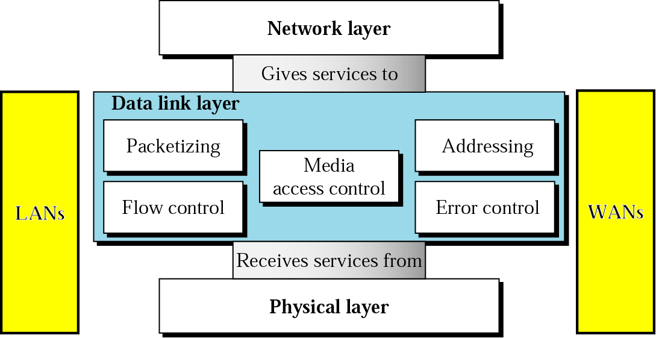
Position of the Data Link Layer

Slide 4
Chapters
Chapter 10 Error Detection and Correction
Chapter 11 Data Link Control
Chapter 12 Multiple Access
Chapter 13 Wired LAN: Ethernet
Chapter 14 Wireless LAN
Chapter 15 Connecting LANs: Backbone
Networks and Virtual LANs
Chapter 16 Wireless WANs: Cellular Telephone
and Satellite Networks
Chapter 17 SONET/ SDH
Chapter 18 Virtual Circuit Networks: Frame
Relay and ATM

Slide 5
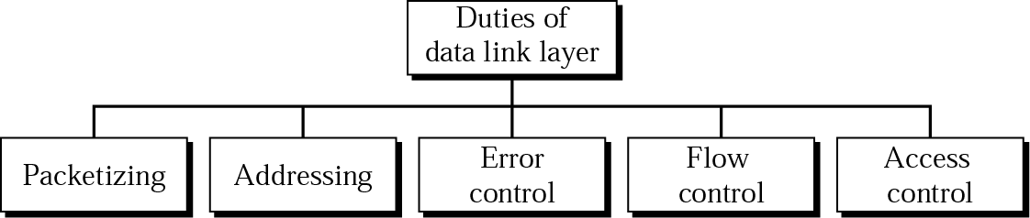
Duties – Data Link Layer

Slide 6
Chapter 10 Error Detection and Correction
Introduction
Block Coding (hamming code, geomatrical representation)
Linear Block Codes (simple parity check, hamming x2)
Cyclic Codes(shifting L to R, cyclic crc, polynomial(crc),)
Checksum

Slide 7
Introduction
Types of Errors

Slide 8
Introduction
Single Bit Error
In a single-bit error, only one bit in the data unit has changed.

Slide 9
Introduction
Multiple Bit Error

Slide 10
Introduction
Burst Error
A burst error means that 2 or more bits in the data unit have changed.

Slide 11
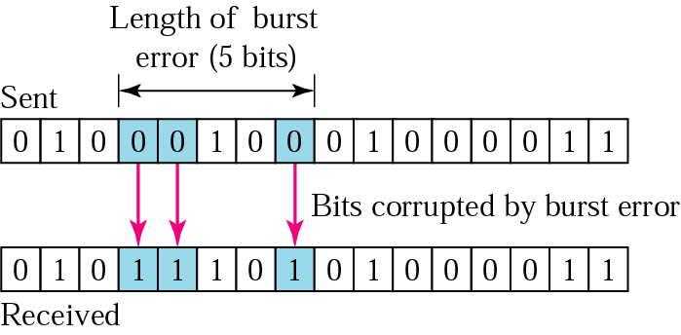
Introduction
Burst Error

Slide 12
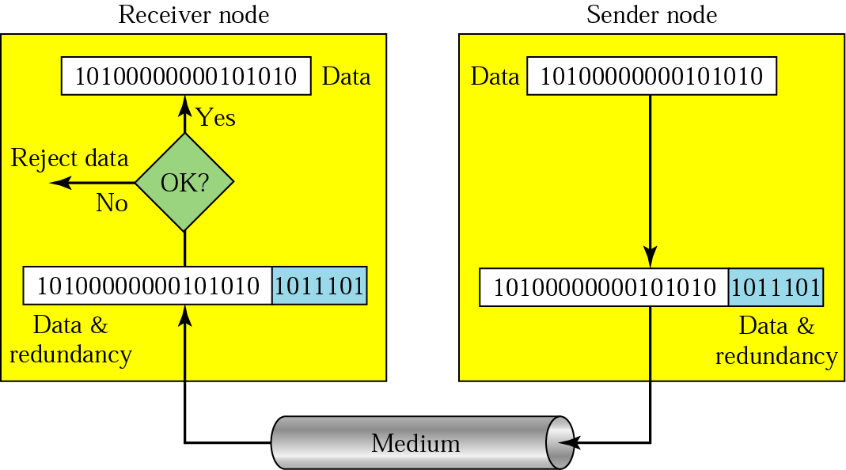
Introduction
Redundancy
Error detection uses the concept of redundancy, which means adding extra bits for detecting errors at the destination.

Slide 13
Introduction
Concepts
Error Detection
Error Correction
Forward Error Correction
Retransmission
Coding (Block coding/ Convolution Coding)
Modular Arithmetic

Slide 14
Block Codes
In block coding, we divide our message into blocks, each of k bits, called datawords
We add r redundant bits to each block to make the length n=k+r
The resulting n-bits blocks are called codewords
With k bits, we can create a combination of 2^k datawords; with n bits, we can create 2^n codewords, Since n>k, the number of possible codewords is larger than the number of possible datawords
This mean that we have 2^n – 2^k codewords that are not used
We call these codewords invalid or illegal

Slide 15
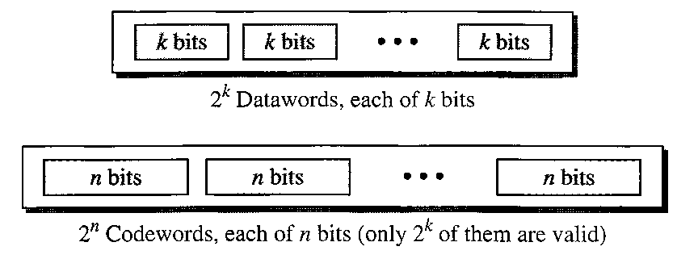
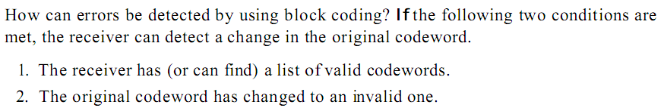
Block Codes
Datawords and Codewords
Error Detection

Slide 16
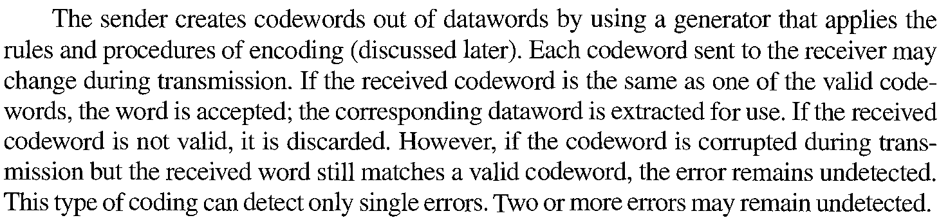
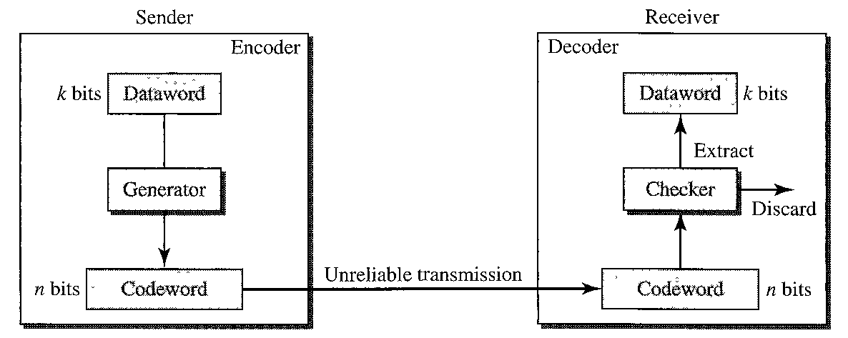
Block Codes
Error Detection

Slide 17
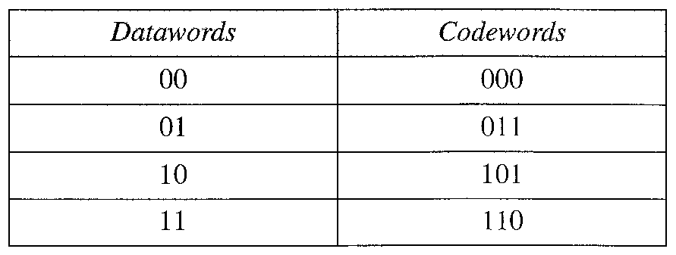
Block Codes
Error Detection - Example

Slide 18
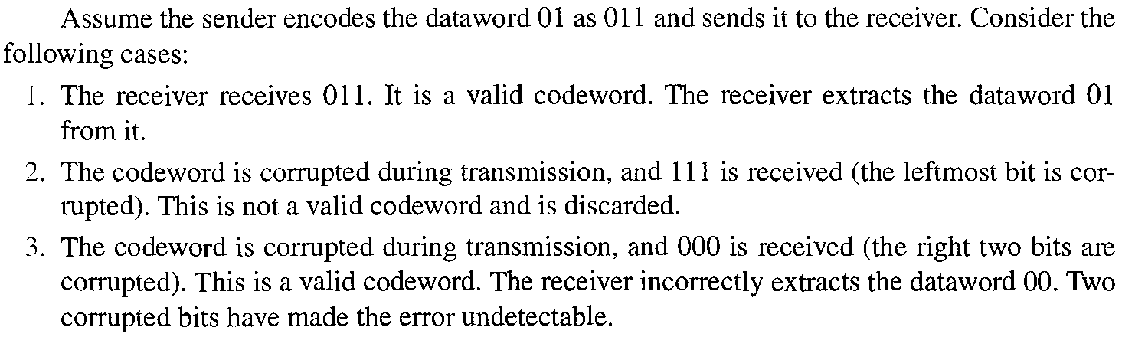
Block Codes
Error Detection - Example

Slide 19
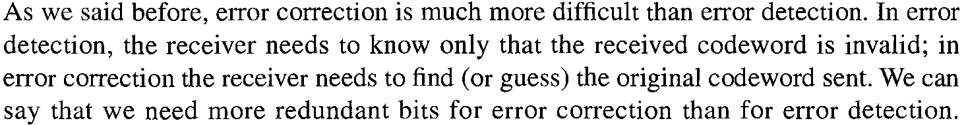
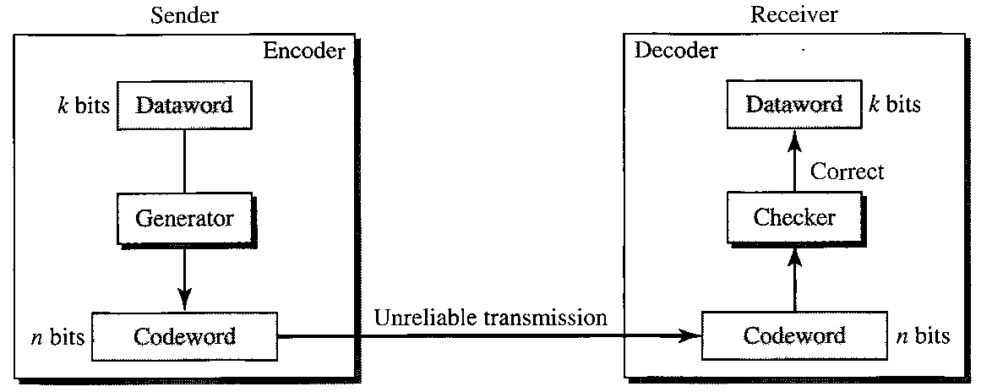
Block Codes
Error Correction

Slide 20
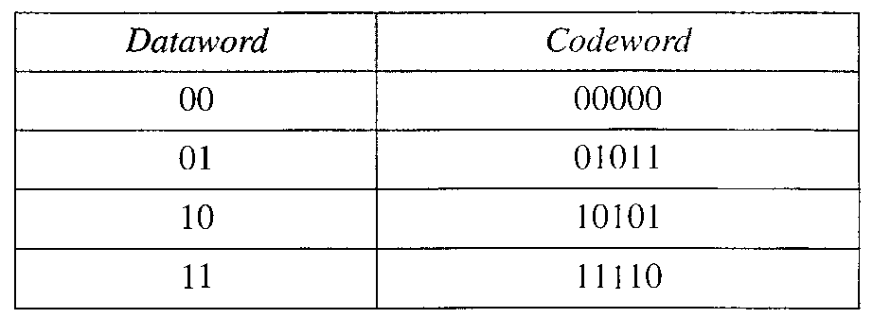
Block Codes
Error Correction - Example
Let us assume that k=2 and n=5 (3 x redundant Bits are used)

Slide 21
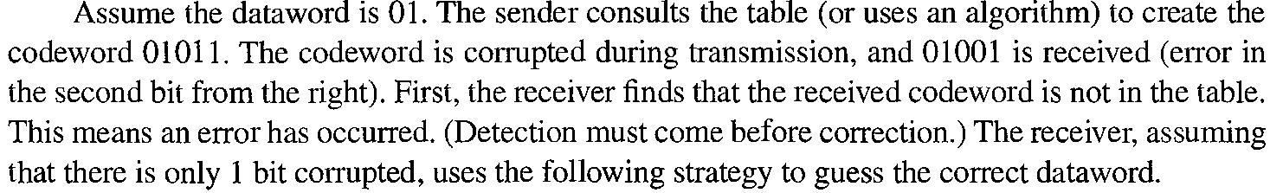
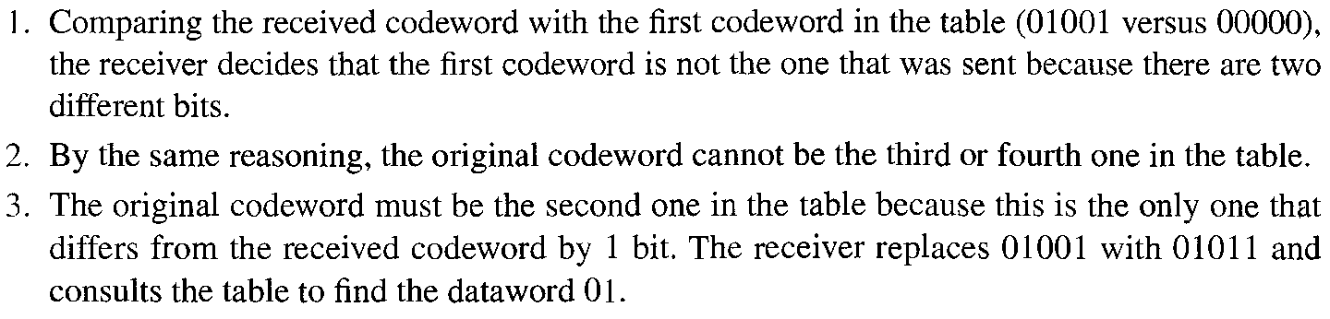
Block Codes
Error Correction - Example

Slide 22

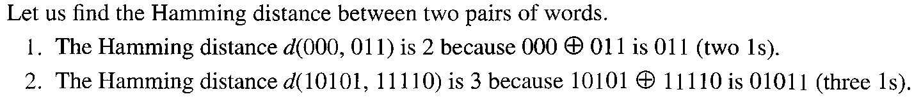
Block Codes
Hamming Distance

Slide 23
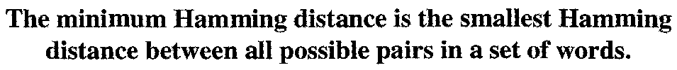
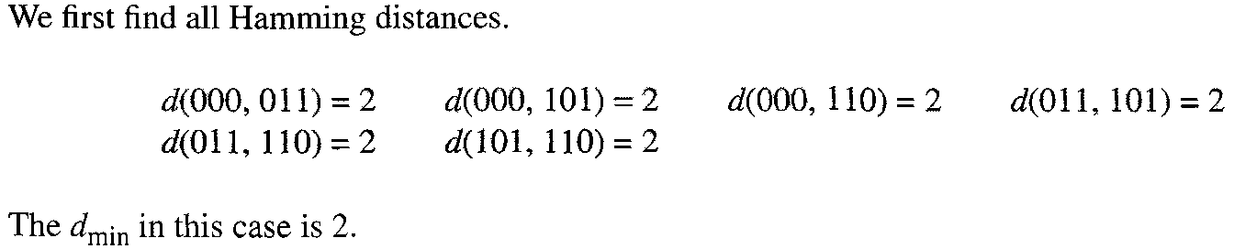
Block Codes
Minimum Hamming Distance

Slide 24
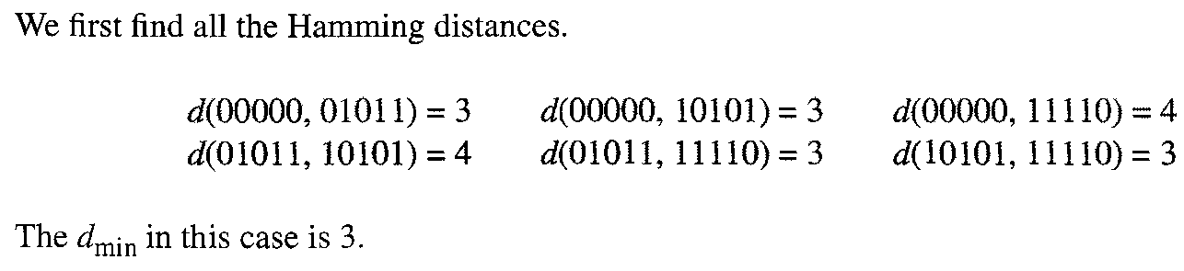
Block Codes
Minimum Hamming Distance

Slide 25
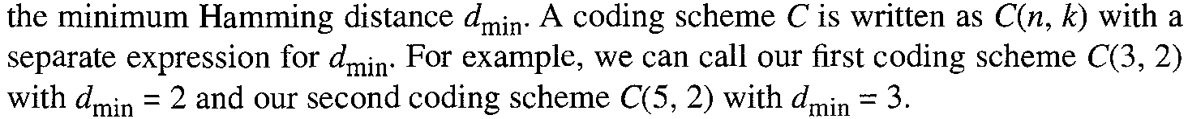
Block Codes
Minimum Distance for Error Detection
Three Parameters
dmin in Example 1 is 2 so only one error can be detected
Similarly, dmin in Example 2 is 3 so only two error can be detected

Slide 26
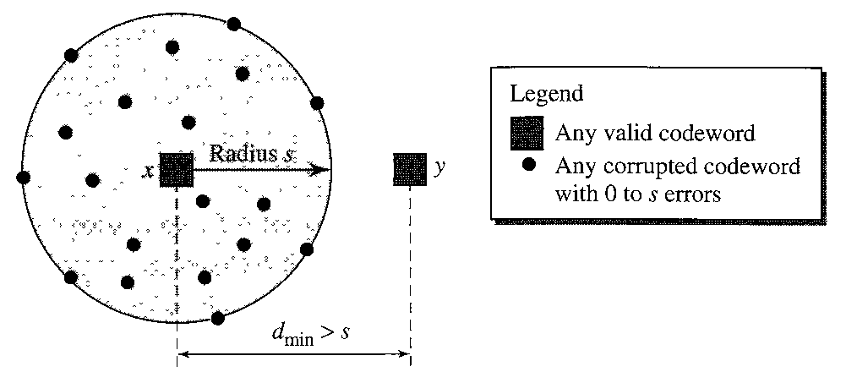
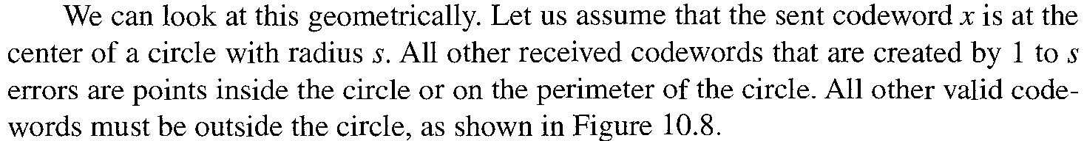
Block Codes
Minimum Distance for Error Correction

Slide 27
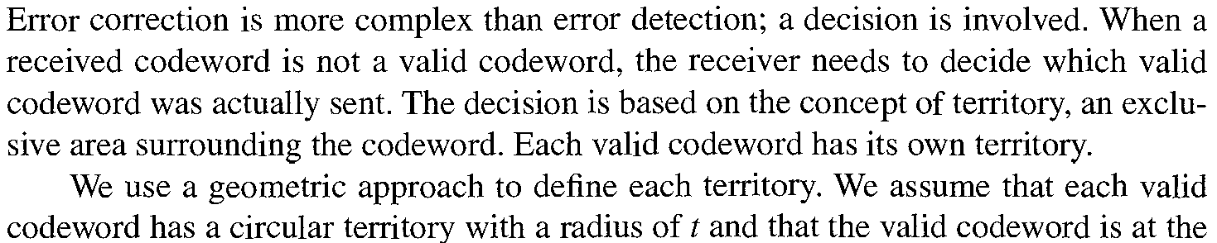
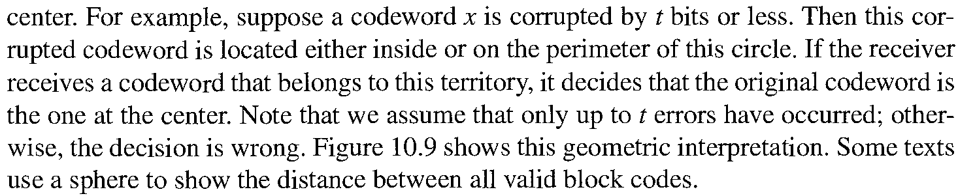
Block Codes
Minimum Distance for Error Correction

Slide 28
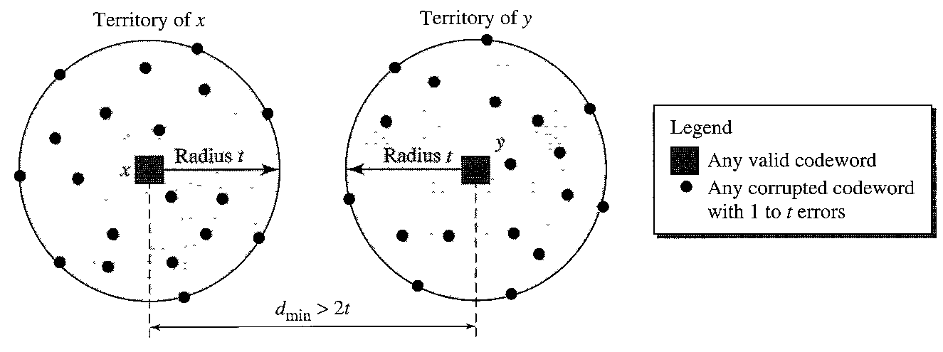
Block Codes
Minimum Distance for Error Correction

Slide 29
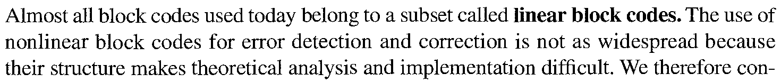

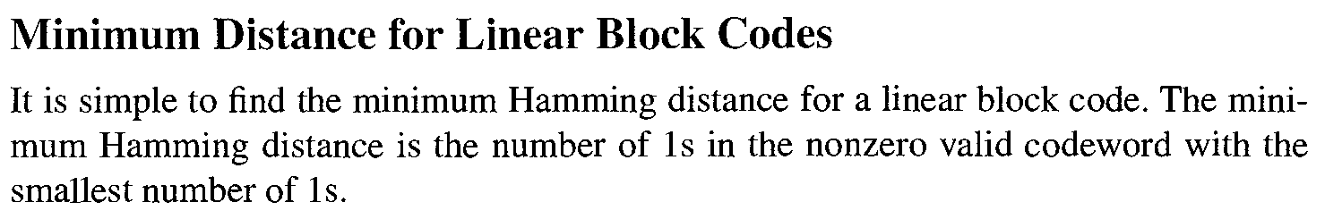
Linear Block Codes

Slide 30

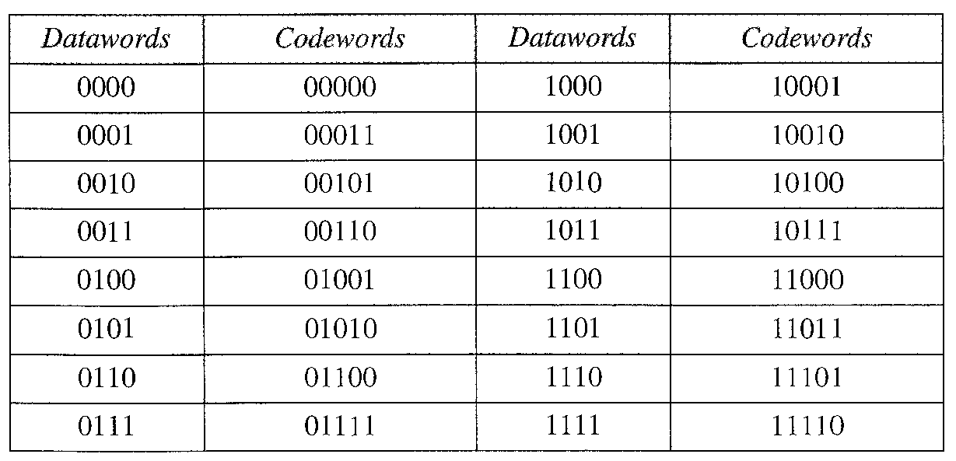
Linear Block Codes
Simple Parity Check Code
In parity check, a parity bit is added to every data unit so that the total number of 1s is even (or odd for odd-parity).

Slide 31
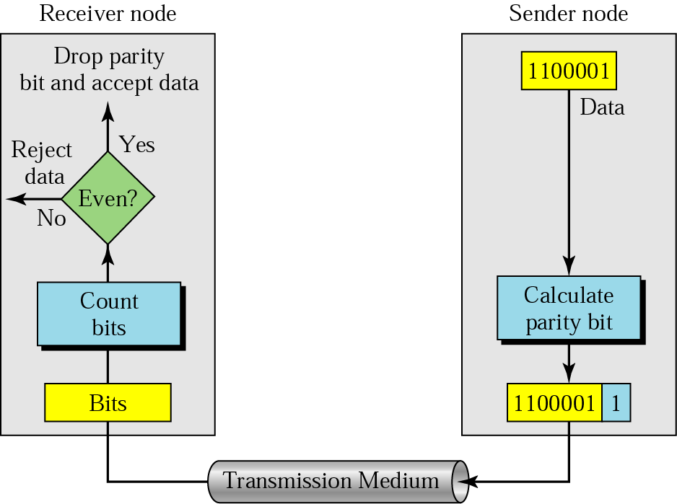
Linear Block Codes
Simple Parity Check Code
Simple parity check can detect all single-bit errors. It can detect burst errors only if the total number of errors in each data unit is odd.

Slide 32
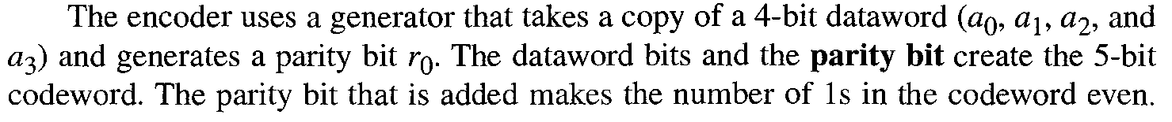

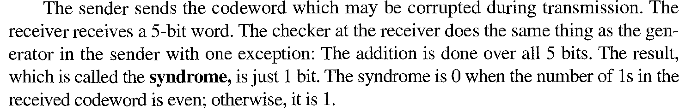
Linear Block Codes
Simple Parity Check Code

Slide 33
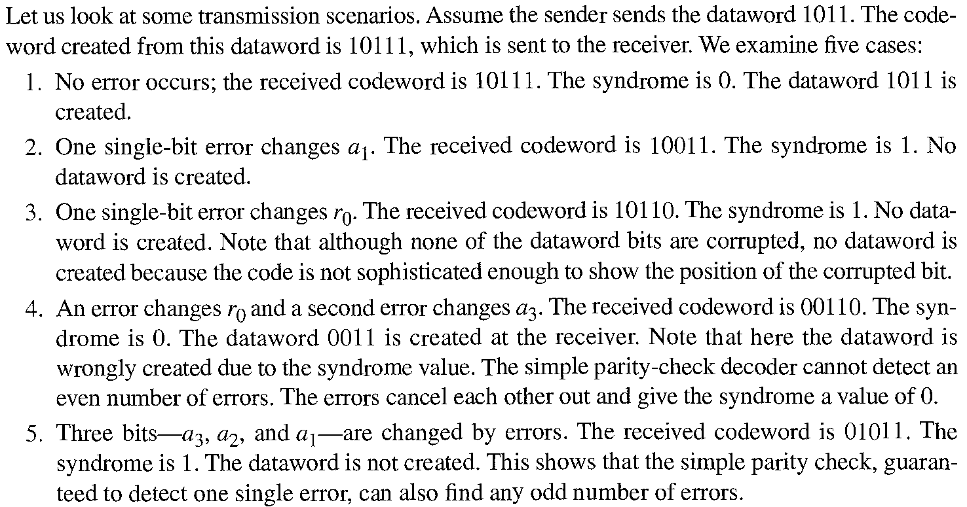
Linear Block Codes
Simple Parity Check Code

Slide 34
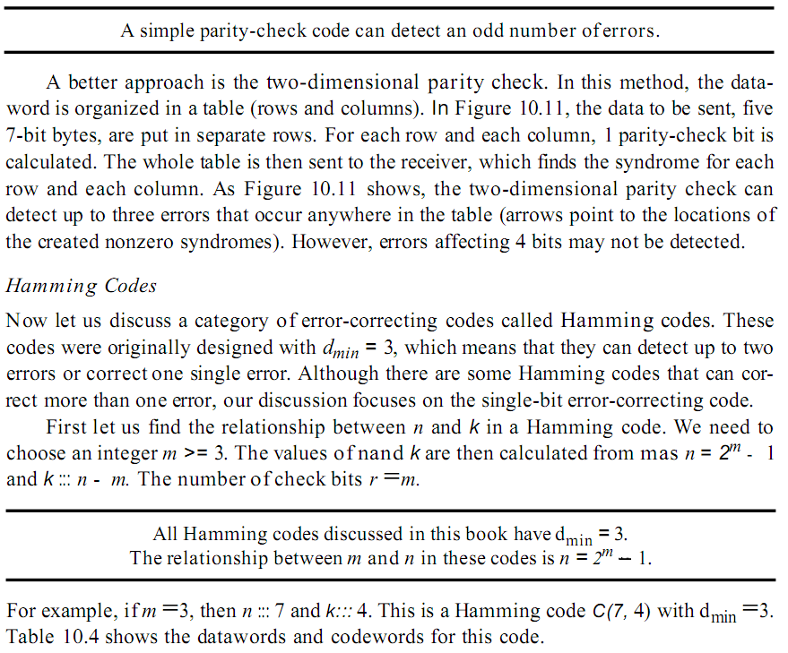
Linear Block Codes
Simple Parity Check Code Addition by me
m=4
n=15
k=11
r=4
d=4

Slide 35
Linear Block Codes
Hamming Codes
Hamming Codes are the Error correction codes
These codes are design with dmin = 3 which mean it can detect 2 error and correct 1 error

Slide 36
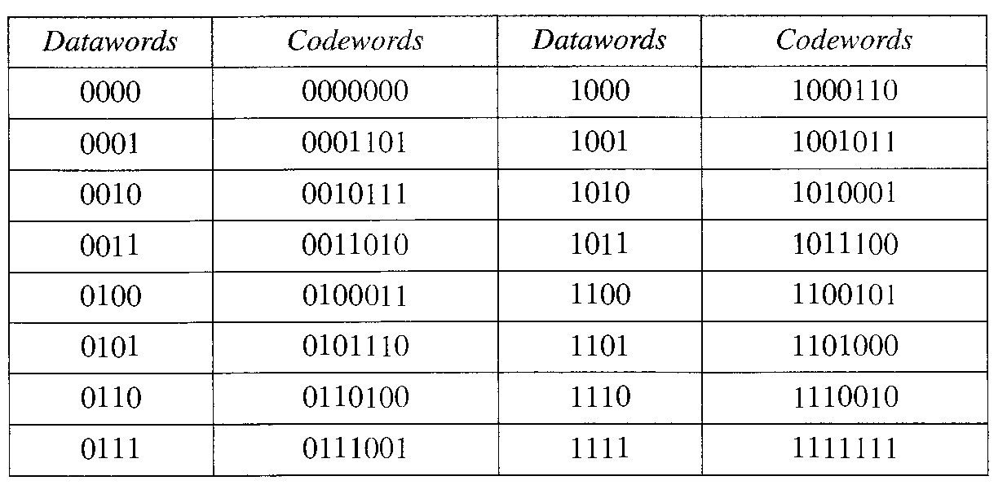
Linear Block Codes
Hamming Codes

Slide 37
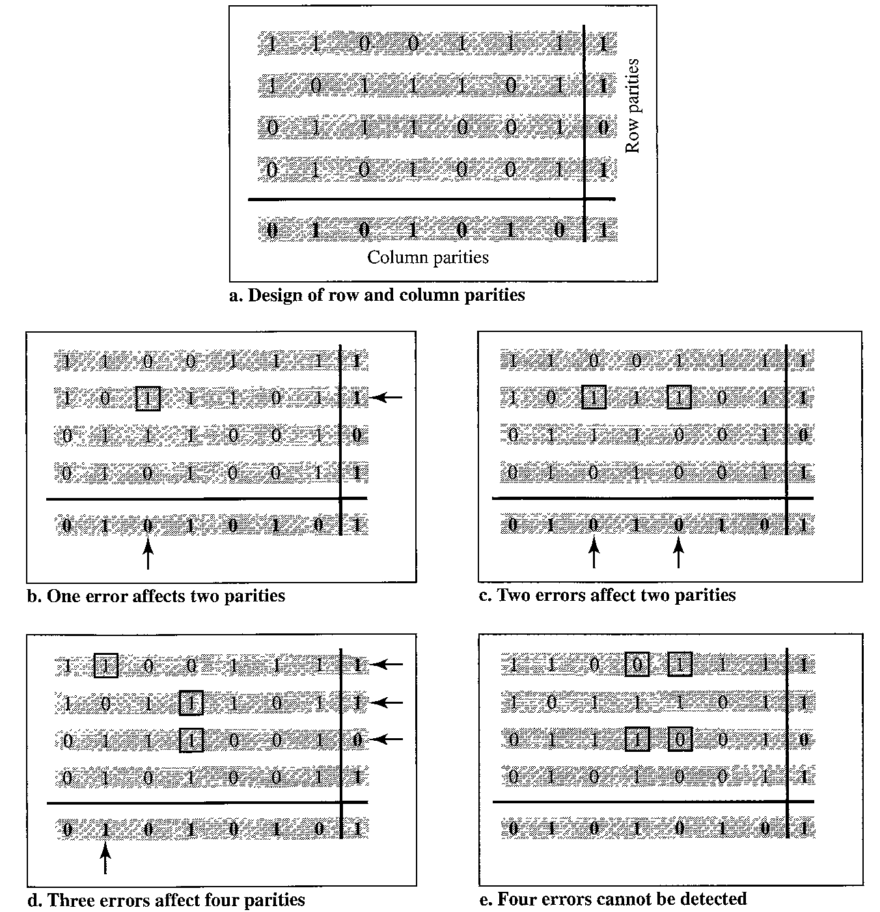
Linear Block Codes
Hamming Codes

Slide 38
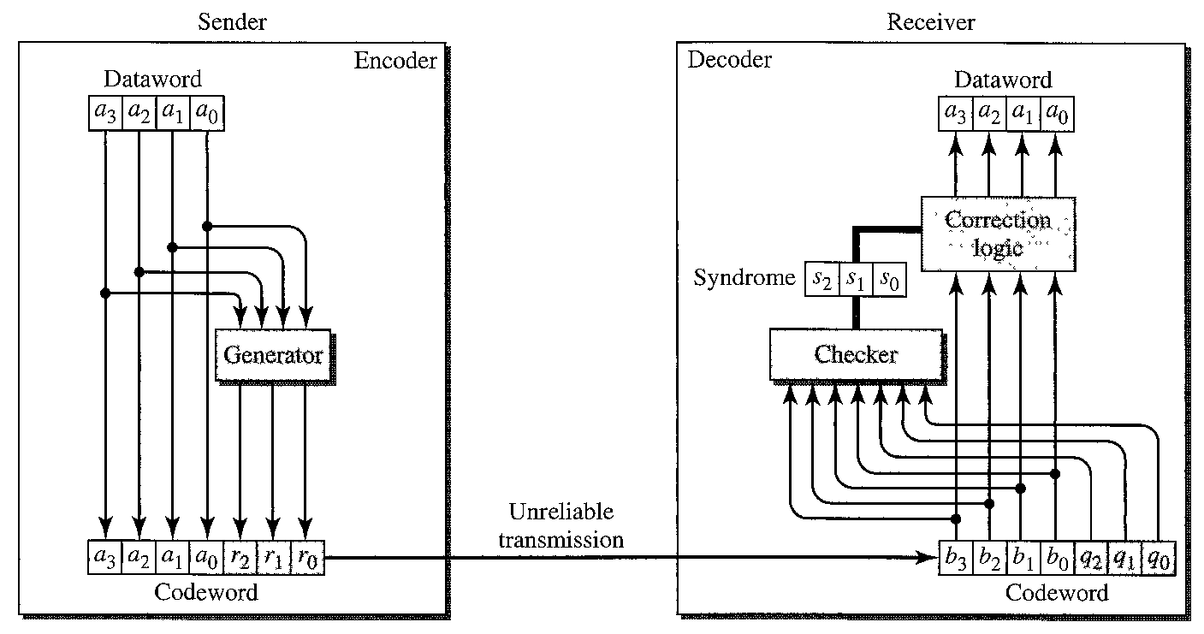
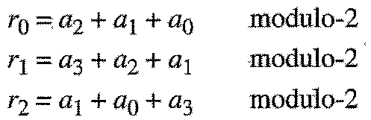
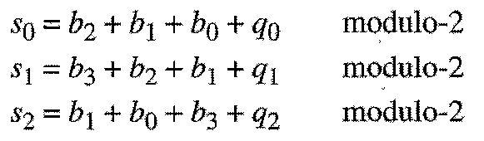
Linear Block Codes
Hamming Codes

Slide 39
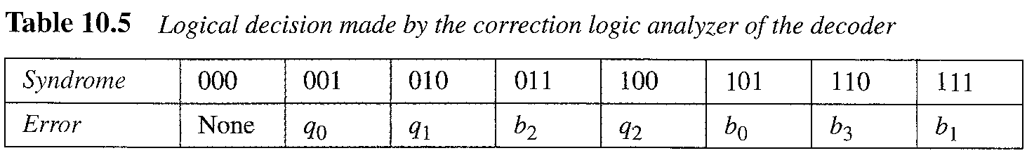
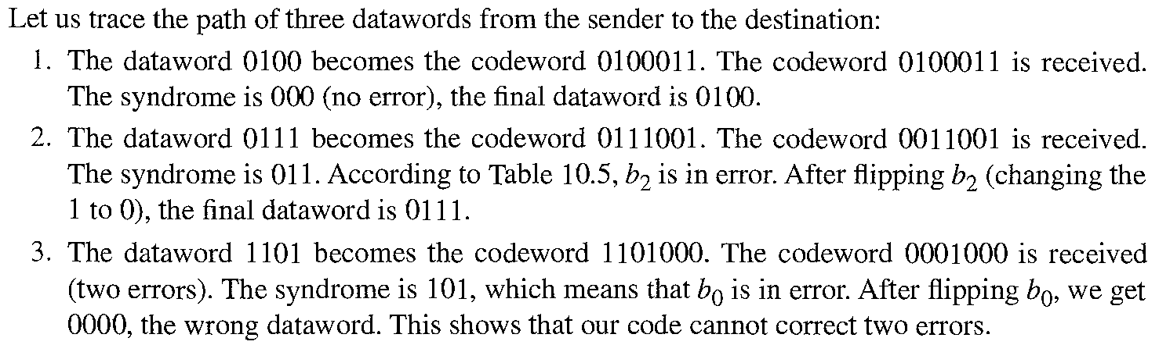
Linear Block Codes
Hamming Codes

Slide 40
Linear Block Codes
Hamming Codes

Slide 41
Linear Block Codes
Hamming Codes

Slide 42
Linear Block Codes
Hamming Codes

Slide 43
Linear Block Codes
Hamming Codes

Slide 44
Linear Block Codes
Hamming Codes

Slide 45
Linear Block Codes
Hamming Codes

Slide 46
Linear Block Codes
Hamming Codes
Number of data bits m | Number of redundancy bits r | Total bits m + r
1 | 2 | 3
2 | 3 | 5
3 | 3 | 6
4 | 3 | 7
5 | 4 | 9
6 | 4 | 10
7 | 4 | 11

Slide 47
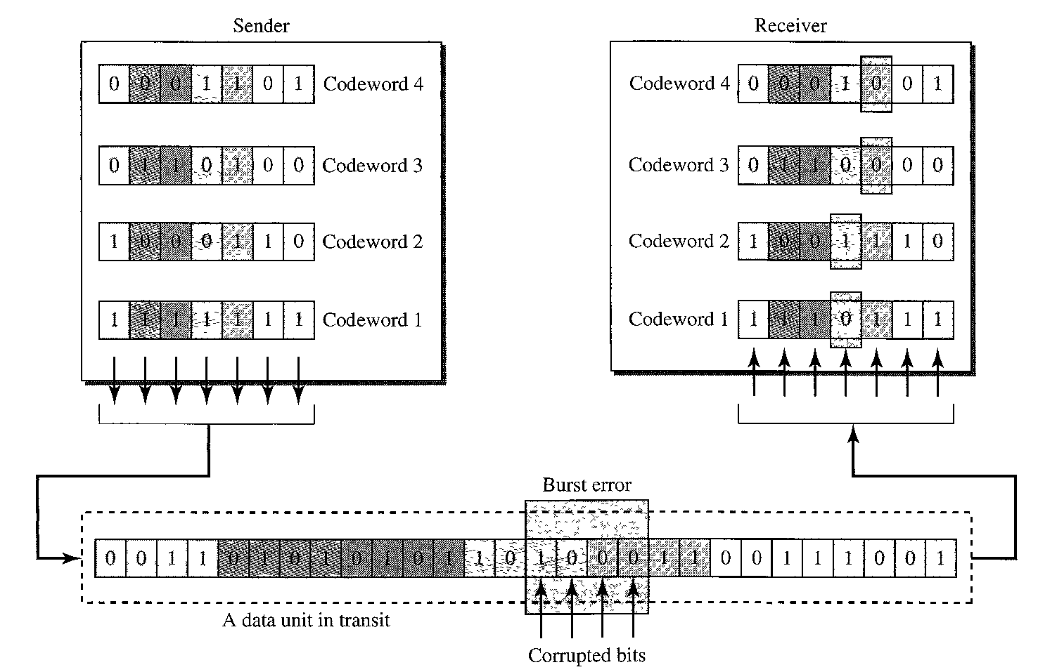
Linear Block Codes
Hamming Codes – Multiple Error Correction

Slide 48
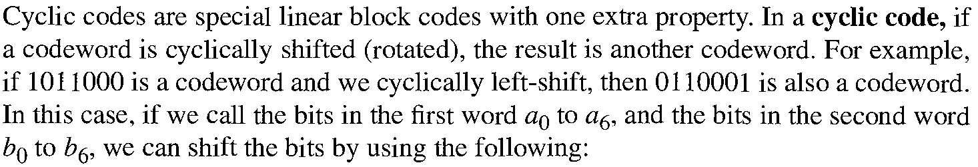
Cyclic Codes

Slide 49
Cyclic Codes
Cyclic Redundancy Code (CRC)

Slide 50
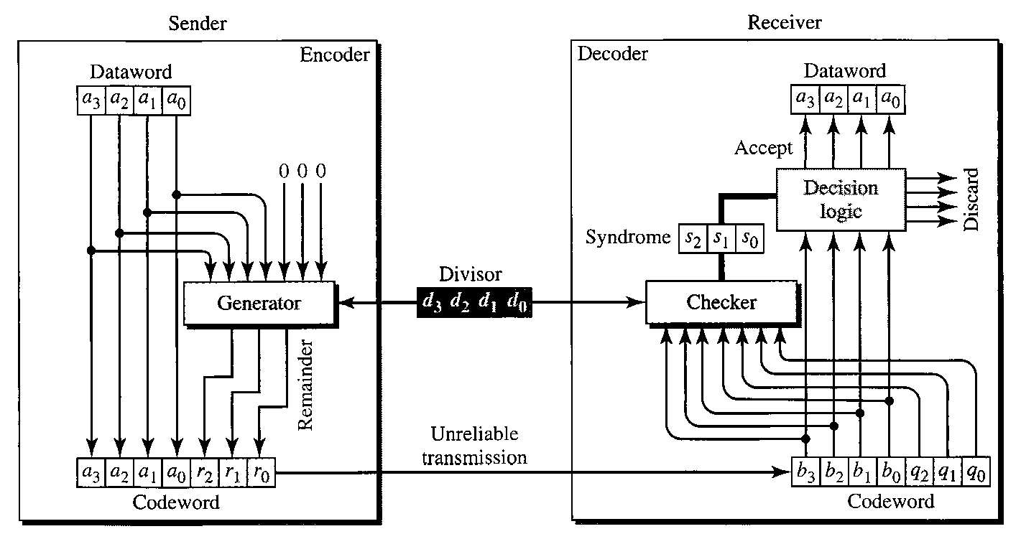
Cyclic Codes
Cyclic Redundancy Code (CRC)

Slide 51
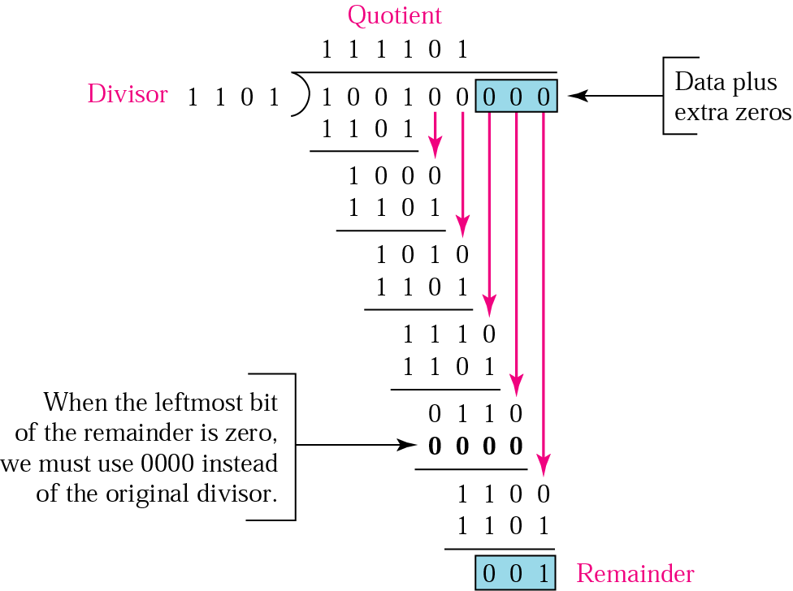
Cyclic Codes
Cyclic Redundancy Code (CRC)
Binary division in a CRC generator

Slide 52
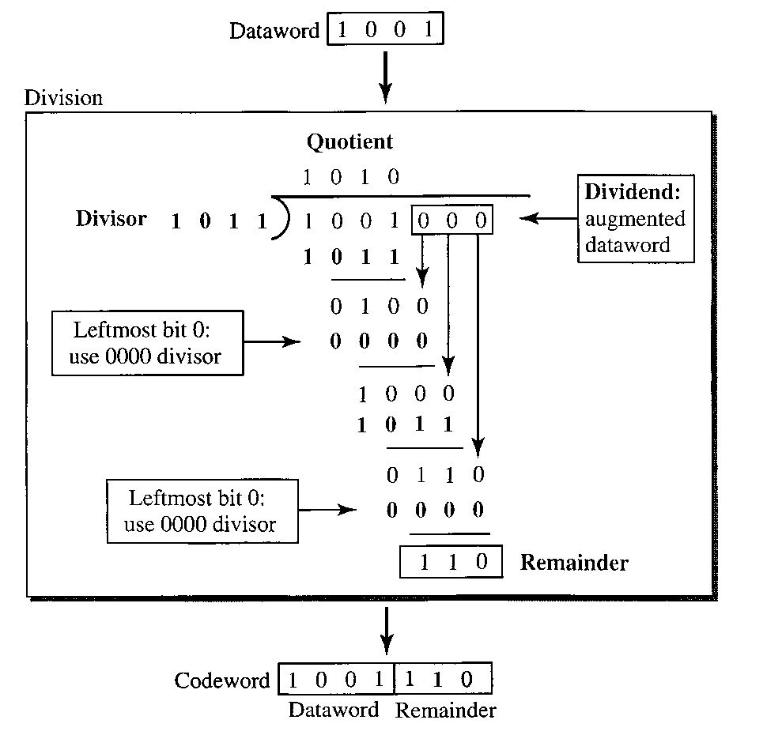
Cyclic Codes
Cyclic Redundancy Code (CRC)

Slide 53

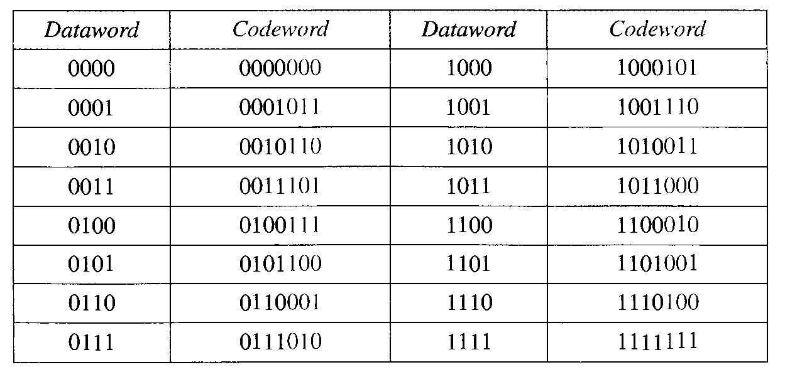
Cyclic Codes
Cyclic Redundancy Code (CRC)

Slide 54
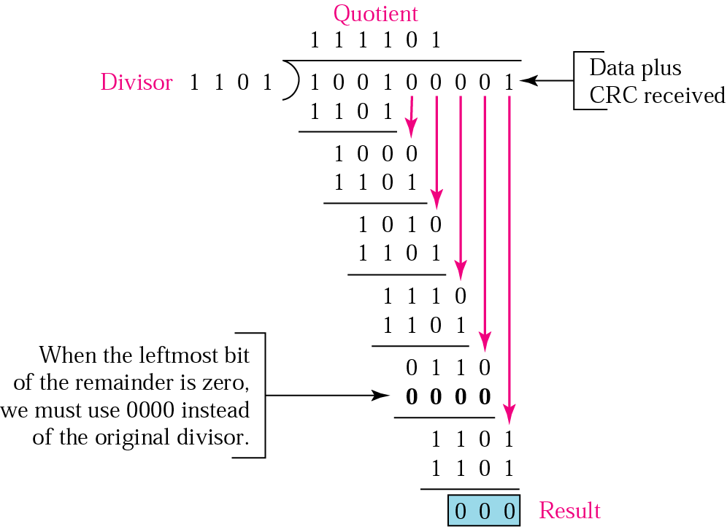
Cyclic Codes
Cyclic Redundancy Code (CRC)
Binary division in CRC checker

Slide 55
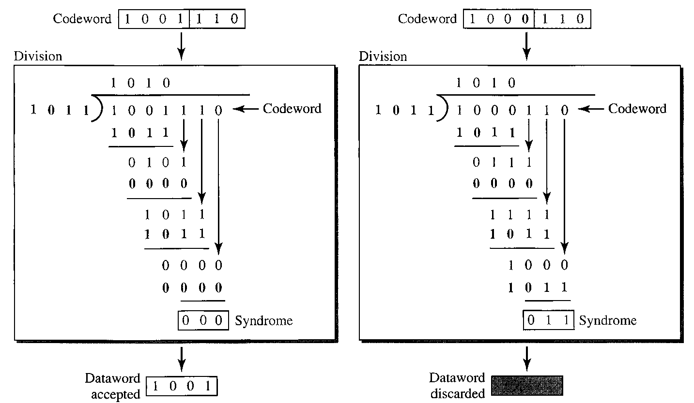
Cyclic Codes
Cyclic Redundancy Code (CRC)

Slide 56
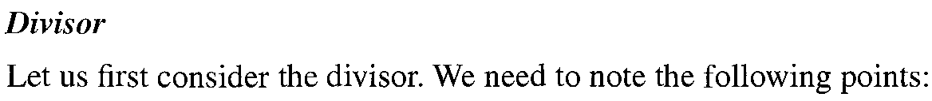
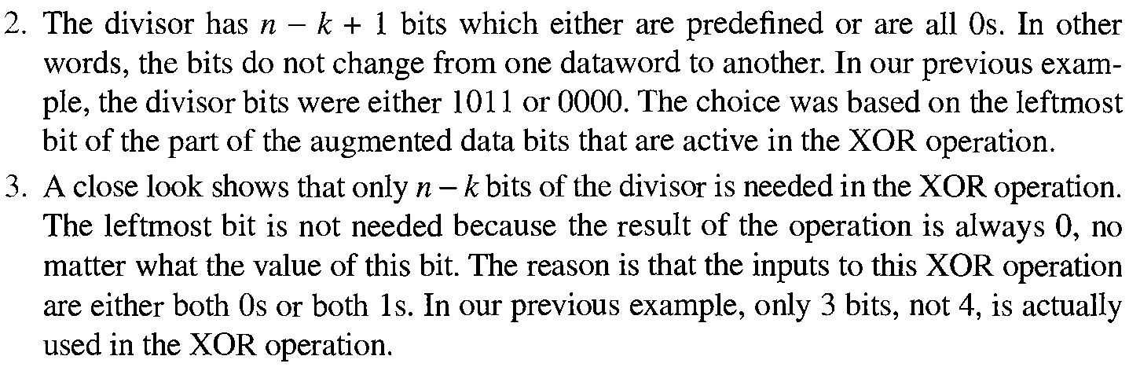
Cyclic Codes
Cyclic Redundancy Code (CRC)

Slide 57


Cyclic Codes
Cyclic Redundancy Code (CRC)

Slide 58


Cyclic Codes
Polynomial

Slide 59
Cyclic Codes
Polynomial

Slide 60



Cyclic Codes
Polynomial

Slide 61

Cyclic Codes
Polynomial

Slide 62
Cyclic Codes
Polynomial
Name | Polynomial | Application
CRC-8 | x⁸ + x² + x + 1 /4 | ATM header
CRC-10 | x¹⁰ + x⁹ + x⁵ + x⁴ + x ² + 1 /6 | ATM AAL
ITU-16 | x¹⁶ + x¹² + x⁵ + 1 /4 | HDLC
ITU-32 | x³² + x²⁶ + x²³ + x²² + x¹⁶ + x¹² + x¹¹ + x¹⁰ + x⁸ + x⁷ + x⁵ + x⁴ + x² + x + 1 /15 | LANs

Slide 63
Check Sum

Slide 64
Check Sum

Slide 65

Check Sum

Slide 66
Check Sum
The sender follows these steps:
The unit is divided into k sections, each of n bits.
All sections are added using one’s complement to get the sum.
The sum is complemented and becomes the checksum.
The checksum is sent with the data.
The receiver follows these steps:
The unit is divided into k sections, each of n bits.
All sections are added using one’s complement to get the sum.
The sum is complemented.
If the result is zero, the data are accepted: otherwise, rejected.

Slide 67
Check Sum
Example
Suppose the following block of 16 bits is to be sent using a checksum of 8 bits.
10101001 00111001
The numbers are added using one’s complement
10101001
00111001 ------------ Sum 11100010
Checksum 00011101
The pattern sent is 10101001 00111001 00011101

Slide 68
Check Sum
Example
Now suppose the receiver receives the pattern sent in Example and there is no error.
10101001 00111001 00011101
When the receiver adds the three sections, it will get all 1s, which, after complementing, is all 0s and shows that there is no error.
10101001
00111001
00011101
Sum 11111111
Complement 00000000 means that the pattern is OK.

Slide 69
Check Sum
Example
Now suppose there is a burst error of length 5 that affects 4 bits. 10101111 11111001 00011101
When the receiver adds the three sections, it gets
10101111
11111001
00011101
Partial Sum 1 11000101
Carry 1
Sum 11000110
Complement 00111001 the pattern is corrupted.

Slide 70

Check Sum

